Slide 1
How Geography Impacts Shopping Patterns,
Habits And E-Commerce
Across Canada
Totem Research Study - January 2023

Slide 2
Study details
How Geography Impacts Shopping Habits, Patterns and E-Commerce​
A Research Study highlighting the differences between Urban and Rural Canadians as they relate to their shopping habits and preferences for purchasing various products and services
A panel plus limited phone recruit with online completion study of 2,492 Canadians was undertaken by Totum Research​
​
Timing: February 2023 ​
​
Community size:​
Urban (10K+ population)​
Rural (<10K population)​
Rural was further divided into <5K and 5K - 9.9K​
​
Regional quotas, community size, age and gender targets were applied to ensure valid representation​
​
Weights were applied to the final database to ensure regions, community size, gender and age groups were representative of the English Canadian population ​

Slide 3
Store Visits by Type/In-Person/Online
Participants were asked to provide insights into how frequently they visit certain store types, both in-person and online, over 1-month, 3-month and annual time periods

Slide 4
Annual shopping patterns
Frequency of visits in a typical year by various store types

Slide 5
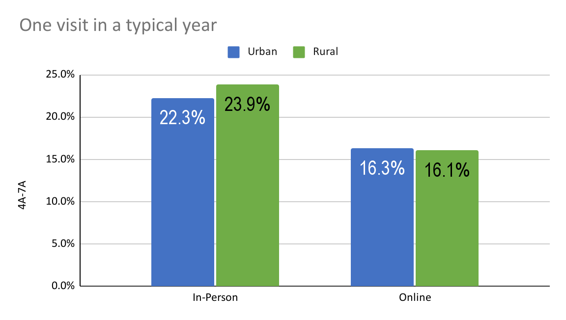
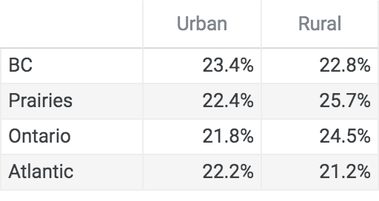
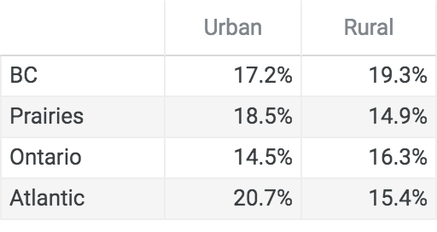
Section: Annual
Q: In a typical year, how often do you visit each of the following store types:
Car Dealership (excluding regular service)
In Person
Online

Slide 6
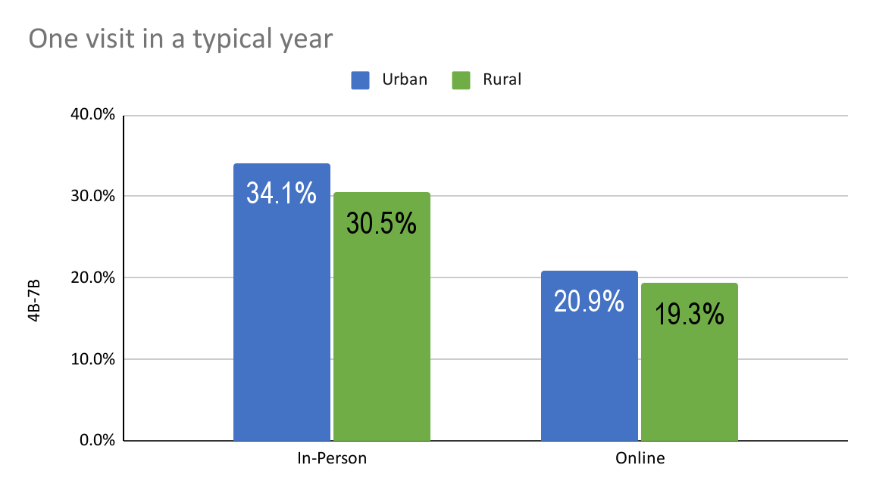
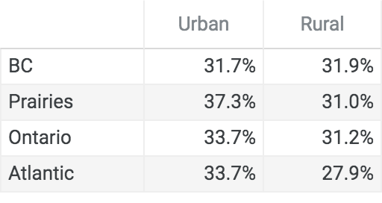
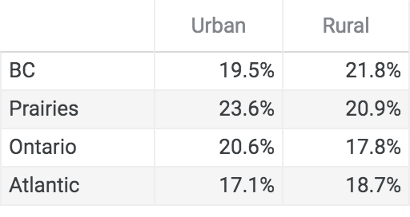
Section: Annual
Q: In a typical year, how often do you visit each of the following store types: Telecommunications Store
In Person
Online

Slide 7
Quarterly shopping patterns
Frequency of visits 3+ times in a typical 3-month period by various store types

Slide 8
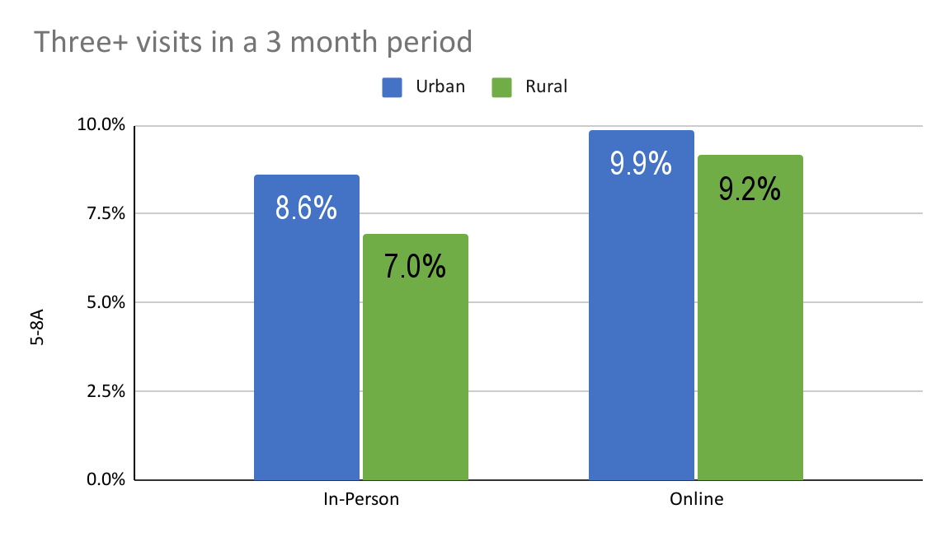
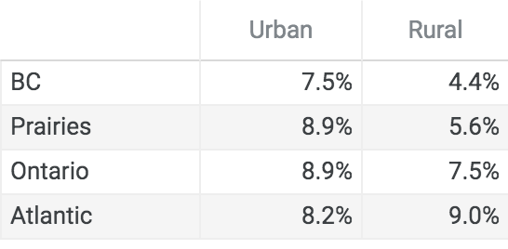
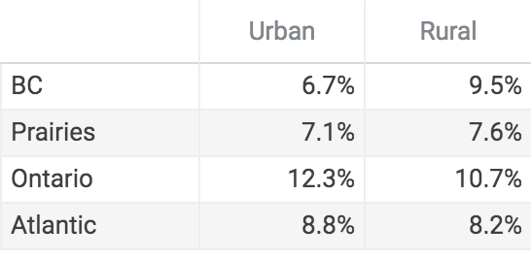
Section: Quarterly
Q: In a 3 month period, how often do you visit each of the following store types: Home Electronics Store
In Person
Online

Slide 9
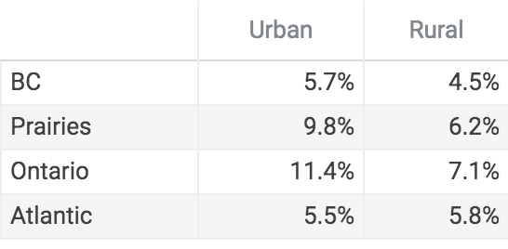
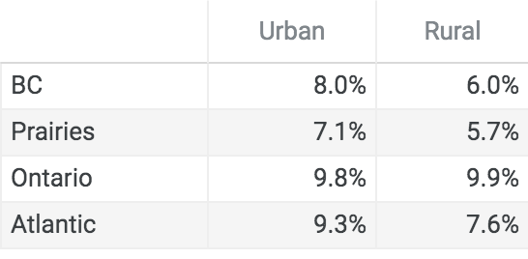
Section: Quarterly
Q: In a 3 month period, how often do you visit each of the following store types:
Furniture/Home decor store
In Person
Online

Slide 10
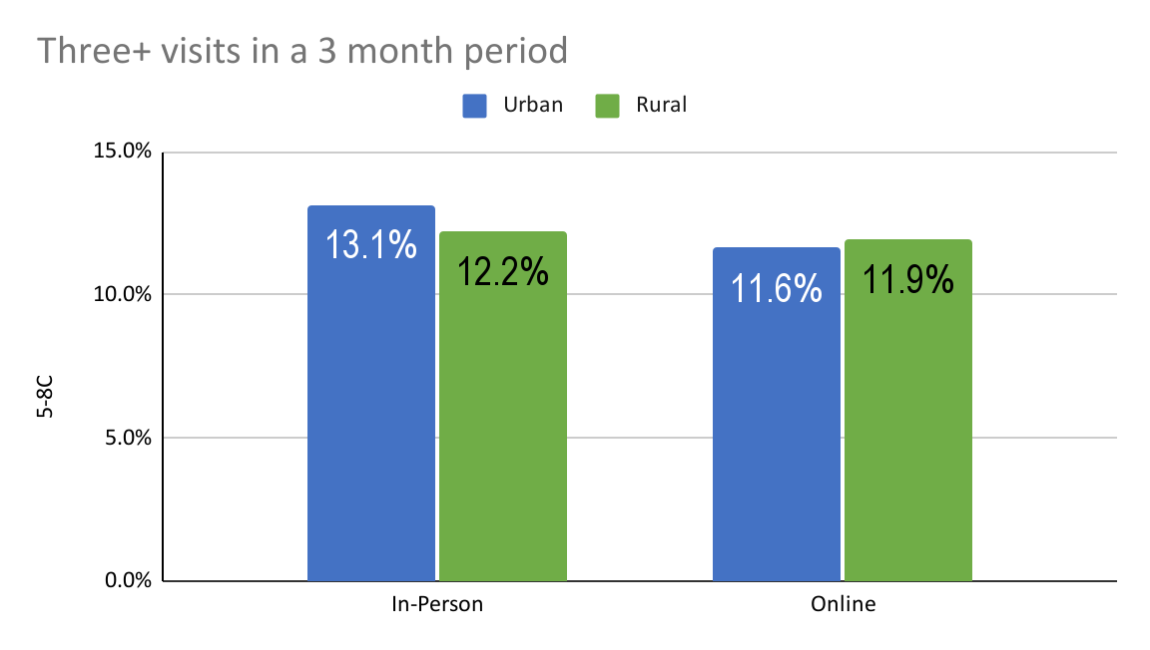
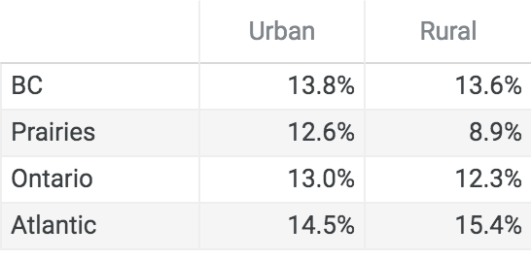
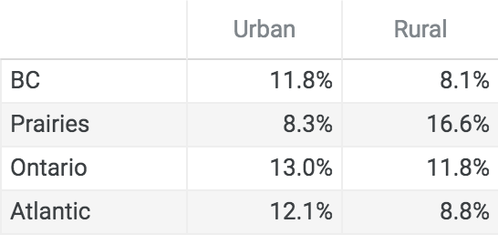
Section: Quarterly
Q: In a 3 month period, how often do you visit each of the following store types: Clothing store/shoe store/boutique
In Person
Online

Slide 11
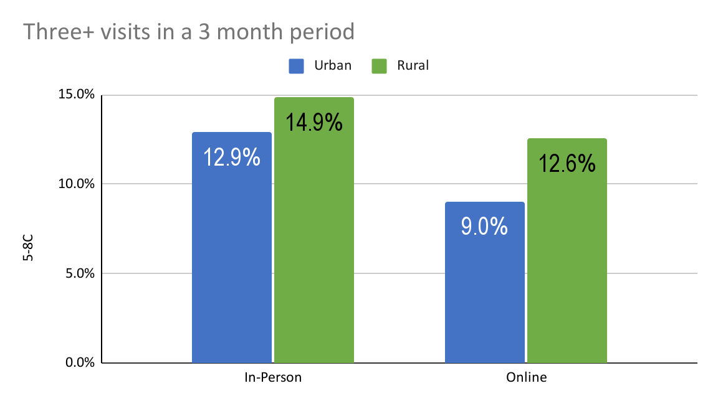
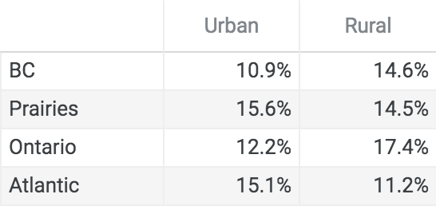
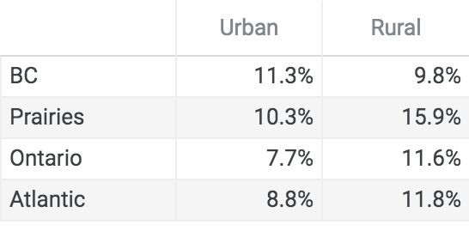
Section: Quarterly
Q: In a 3 month period, how often do you visit each of the following store types: Automotive (Canadian Tire, Fountain Tire, Princess Auto, Mr. Lube, Midas etc.)
In Person
Online

Slide 12
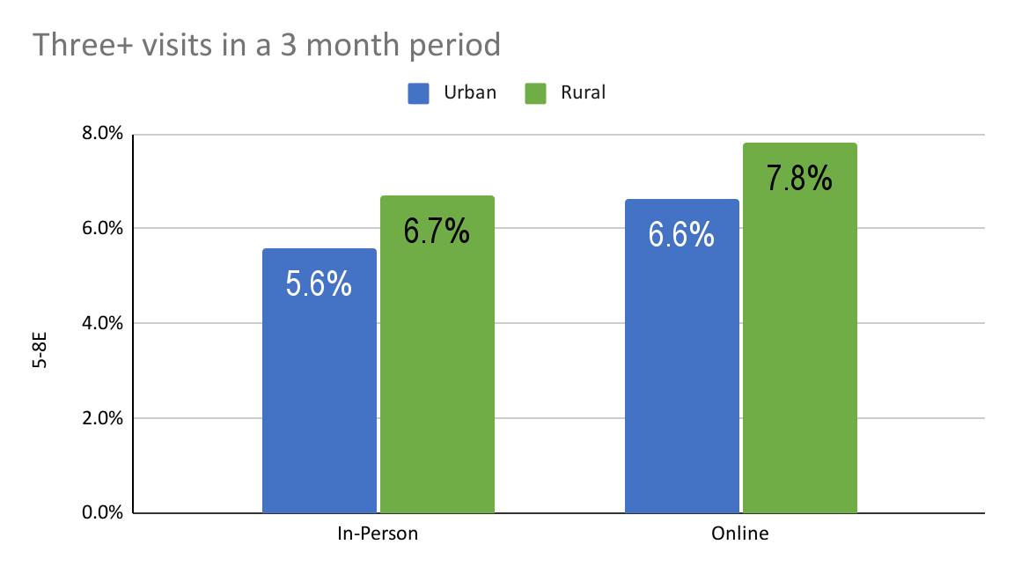
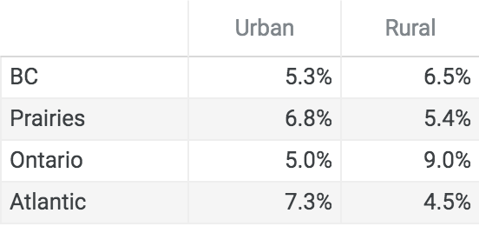
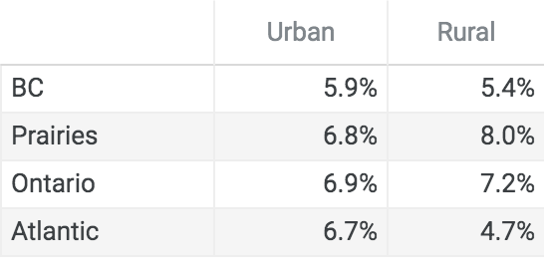
Section: Quarterly
Q: In a 3 month period, how often do you visit each of the following store types: Sporting Goods/Leisure/Hunting store
In Person
Online

Slide 13
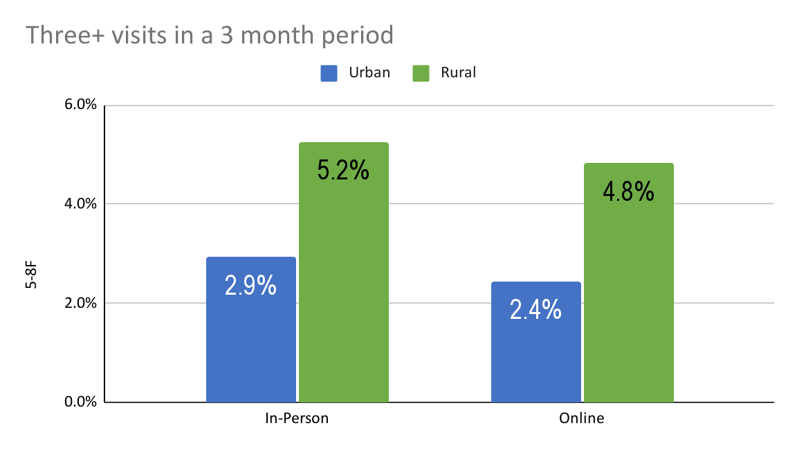
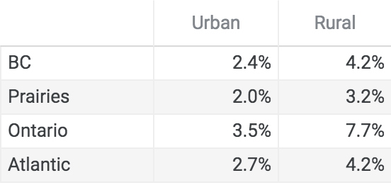
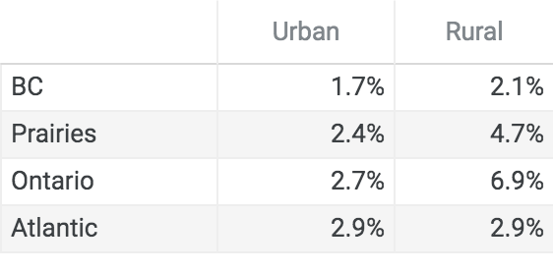
Section: Quarterly
Q: In a 3 month period, how often do you visit each of the following store types: Agriculture supplies store
In Person
Online

Slide 14
Monthly Shopping Patterns
Frequency of visits 3+ times in a typical 1-month period by various store types

Slide 15
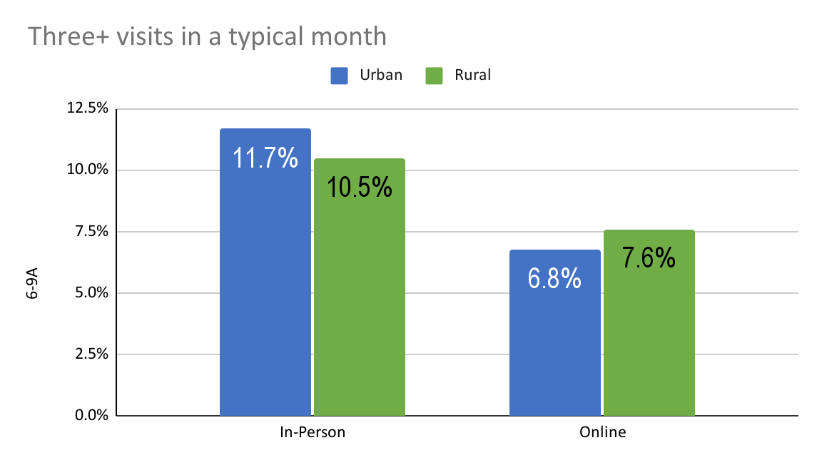
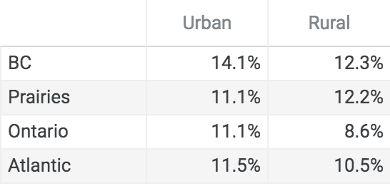
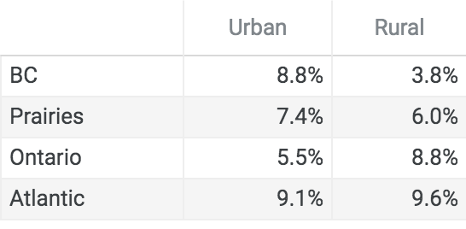
Section: Monthly
Q: In a typical month, how often do you visit each of the following store types: Supermarket
In Person
Online

Slide 16
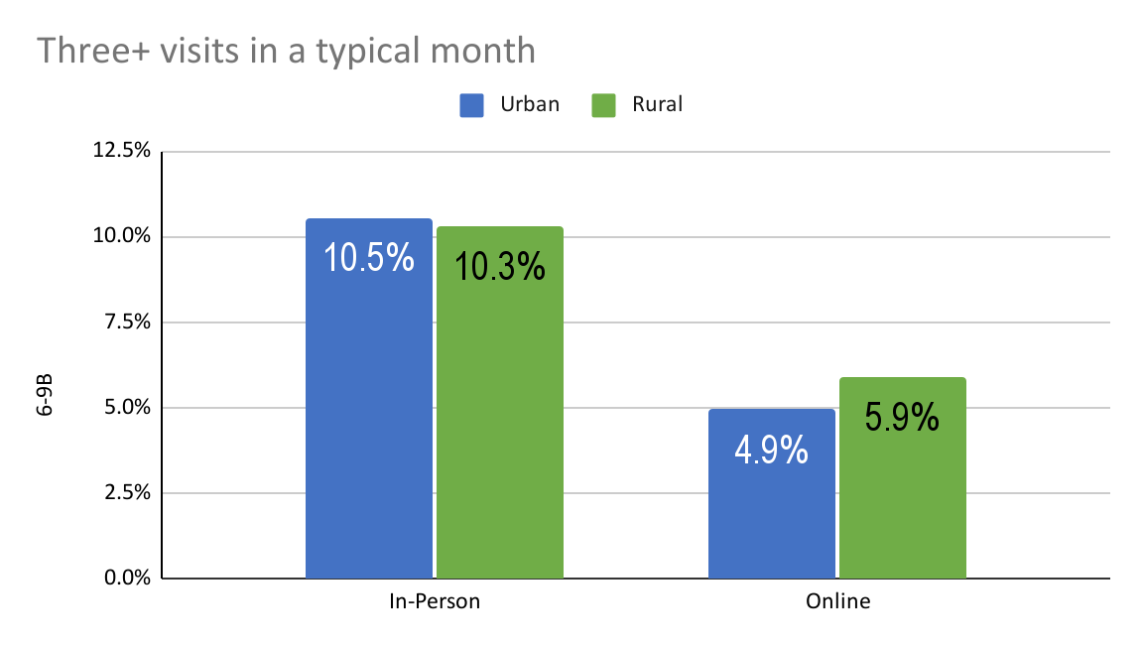
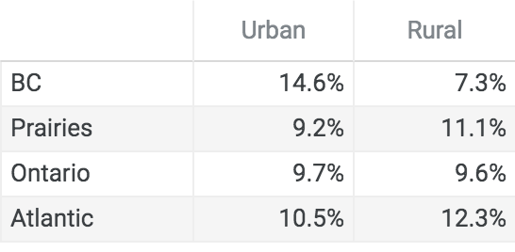
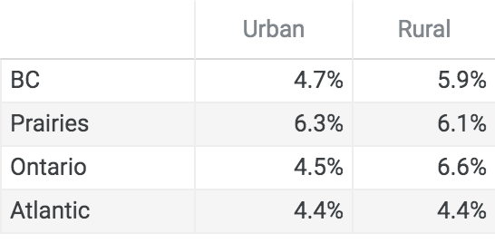
Section: Monthly
Q: In a typical month, how often do you visit each of the following store types: Local grocer
In Person
Online

Slide 17
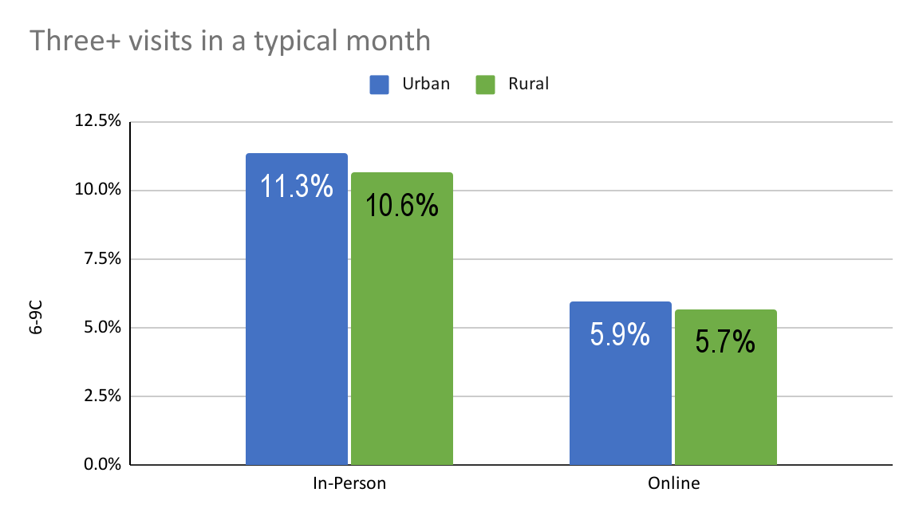
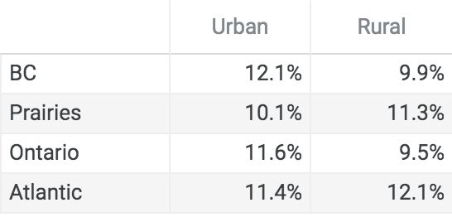
Section: Monthly
Q: In a typical month, how often do you visit each of the following store types: Drug store/pharmacy
In Person
Online

Slide 18
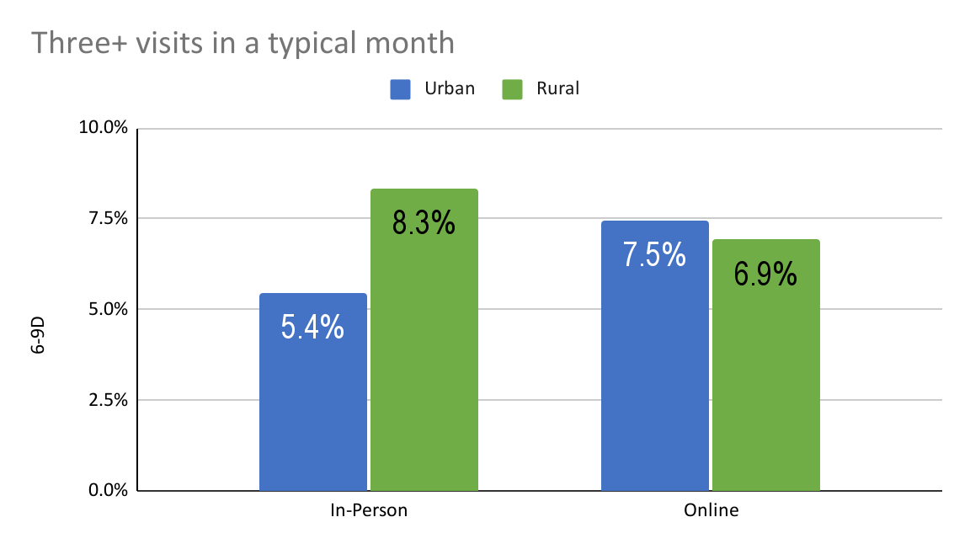
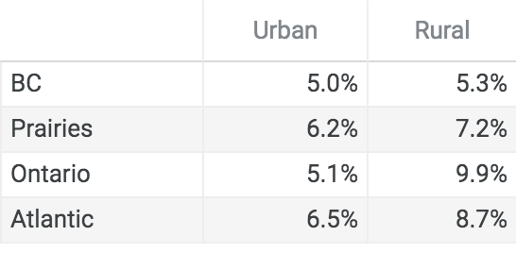
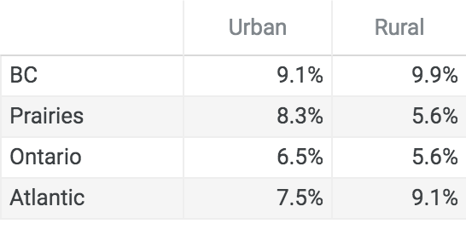
Section: Monthly
Q: In a typical month, how often do you visit each of the following store types: Bank/financial institution
In Person
Online

Slide 19
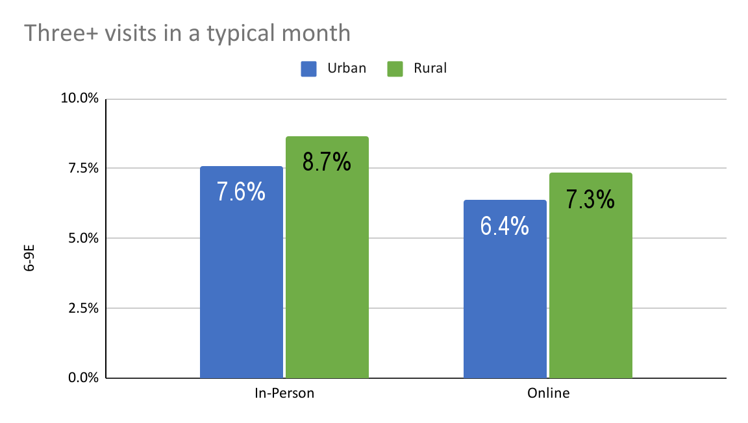
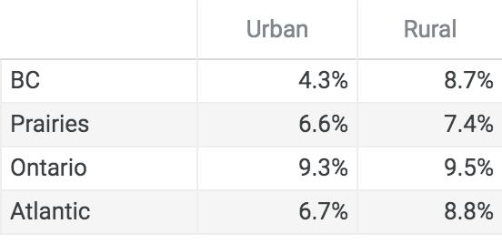
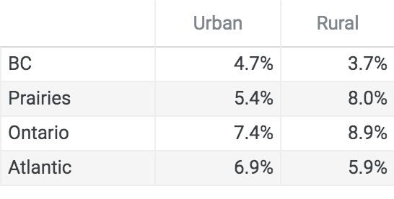
Section: Monthly
Q: In a typical month, how often do you visit each of the following store types: Home improvement/hardware store
In Person
Online

Slide 20
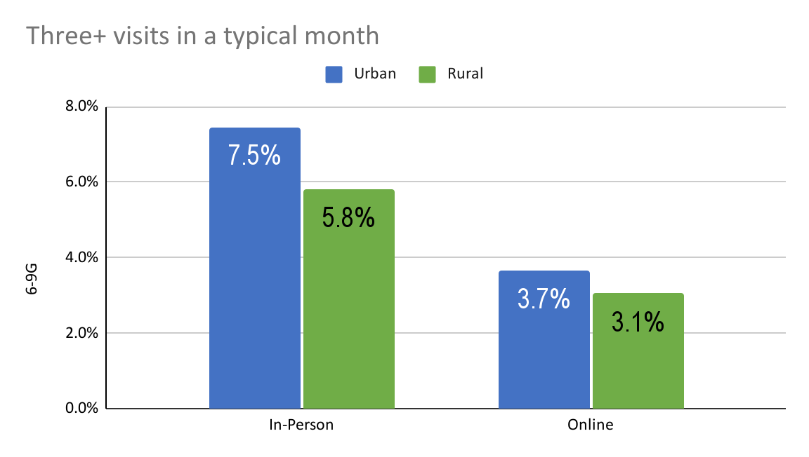
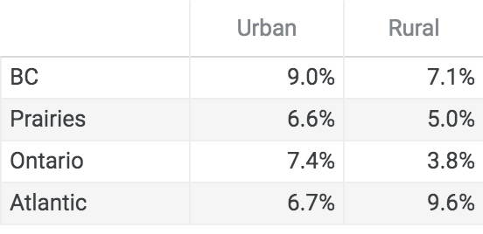
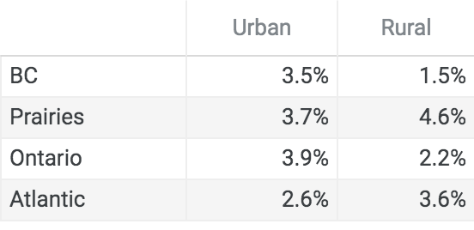
Section: Monthly
Q: In a typical month, how often do you visit each of the following store types: Indoor Shopping Mall
In Person
Online

Slide 21
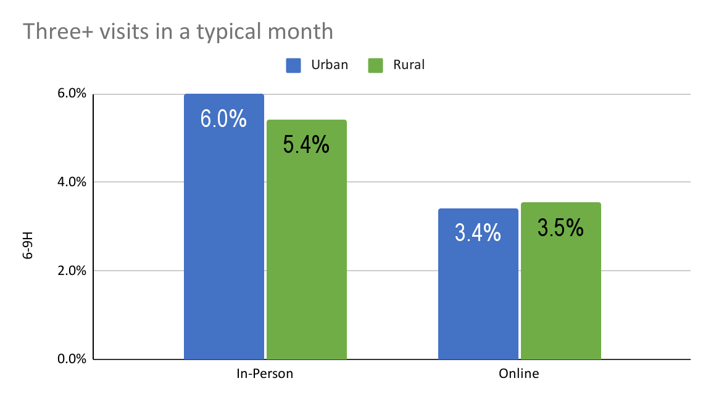
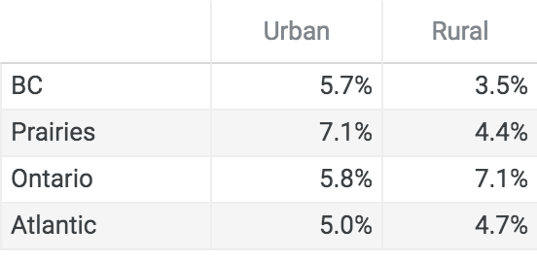
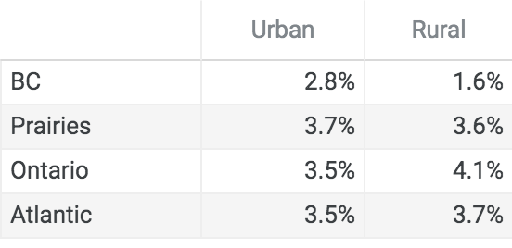
Section: Monthly
Q: In a typical month, how often do you visit each of the following store types: Big Box Shopping Mall or Power Centre
In Person
Online

Slide 22
Sources Used to Purchase
From what sources are respondents purchasing products and services.

Slide 23
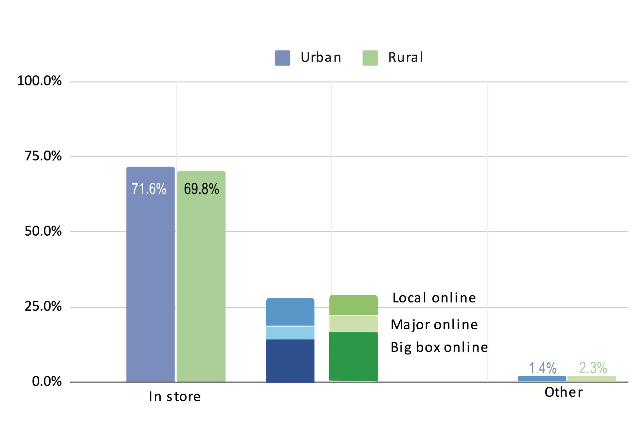
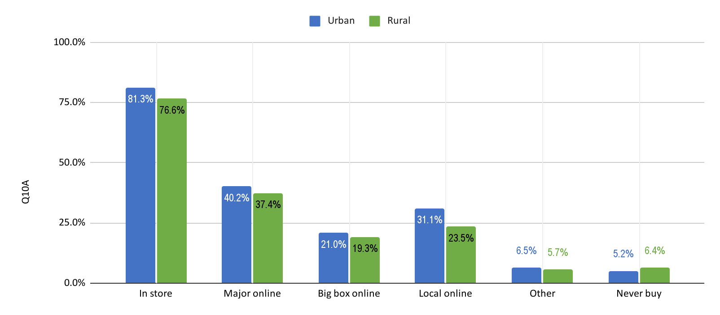
Section: Sources
Q: From which of the sources listed
do you EVER buy the following products and services?: Clothing or footwear
From which of the sources do you buy MOST OFTEN

Slide 24
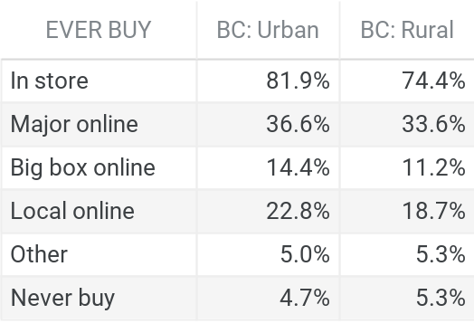
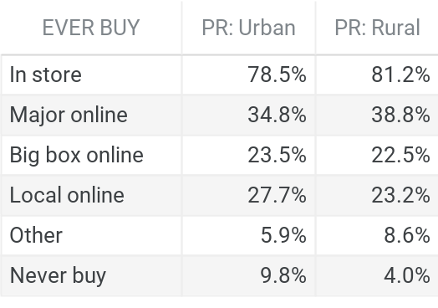
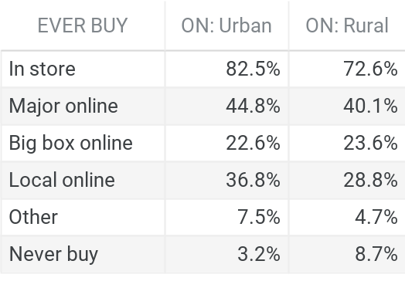
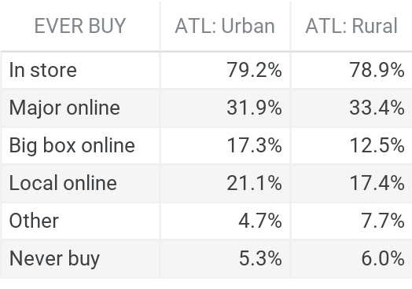
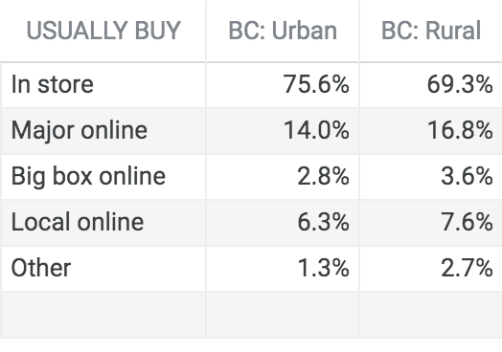
Section: Sources - Urban/Rural Sources Used to Purchase by Region
Q: From which of the sources listed do you buy the following products and services?: Clothing or footwear
BC
Prairies
Ontario
Atlantic
Ever Buy
Usually Buy

Slide 25
Section: Sources
Q: From which of the sources listed
do you EVER buy the following products and services?: Cars or Trucks
From which of the sources do you buy MOST OFTEN

Slide 26
Section: Sources - Urban/Rural Sources Used to Purchase by Region
Q: From which of the sources listed do you buy the following products and services?: Cars or Trucks
BC
Prairies
Ontario
Atlantic
Ever Buy
Usually Buy

Slide 27
Section: Sources
Q: From which of the sources listed
do you EVER buy the following products and services?: Grocery Products
From which of the sources do you buy MOST OFTEN

Slide 28
Section: Sources - Urban/Rural Sources Used to Purchase by Region
Q: From which of the sources listed do you buy the following products and services?: Grocery Products
BC
Prairies
Ontario
Atlantic
Ever Buy
Usually Buy

Slide 29
Section: Sources
Q: From which of the sources listed
do you EVER buy the following products and services?: Financial Products and Services
From which of the sources do you buy MOST OFTEN

Slide 30
Section: Sources - Urban/Rural Sources Used to Purchase by Region
Q: From which of the sources listed do you buy the following products and services?: Financial Products and Services
BC
Prairies
Ontario
Atlantic
Ever Buy
Usually Buy

Slide 31
Section: Sources
Q: From which of the sources listed
do you EVER buy the following products and services?: Telecommunications Products and Services
From which of the sources do you buy MOST OFTEN

Slide 32
Section: Sources - Urban/Rural Sources Used to Purchase by Region
Q: From which of the sources listed do you buy the following products and services?: Telecommunications Products and Services
BC
Prairies
Ontario
Atlantic
Ever Buy
Usually Buy

Slide 33
Section: Sources
Q: From which of the sources listed
do you EVER buy the following products and services?: Hardware/ Home Improvement Products
From which of the sources do you buy MOST OFTEN

Slide 34
Section: Sources - Urban/Rural Sources Used to Purchase by Region
Q: From which of the sources listed do you buy the following products and services?: Hardware/ Home Improvement Products
BC
Prairies
Ontario
Atlantic
Ever Buy
Usually Buy

Slide 35
Section: Sources
Q: From which of the sources listed
do you EVER buy the following products and services?: Home Electronics
From which of the sources do you buy MOST OFTEN

Slide 36
Section: Sources - Urban/Rural Sources Used to Purchase by Region
Q: From which of the sources listed do you buy the following products and services?: Home Electronics
BC
Prairies
Ontario
Atlantic
Ever Buy
Usually Buy

Slide 37
Section: Sources
Q: From which of the sources listed
do you EVER buy the following products and services?: Healthcare Products and Services
From which of the sources do you buy MOST OFTEN

Slide 38
Section: Sources - Urban/Rural Sources Used to Purchase by Region
Q: From which of the sources listed do you buy the following products and services?: Healthcare Products and Services
BC
Prairies
Ontario
Atlantic
Ever Buy
Usually Buy

Slide 39
Section: Sources
Q: From which of the sources listed
do you EVER buy the following products and services?: Recreational Products and Services
From which of the sources do you buy MOST OFTEN

Slide 40
Section: Sources - Urban/Rural Sources Used to Purchase by Region
Q: From which of the sources listed do you buy the following products and services?: Recreational Products and Services
BC
Prairies
Ontario
Atlantic
Ever Buy
Usually Buy

Slide 41
Section: Sources
Q: From which of the sources listed
do you EVER buy the following products and services?: Agricultural Products and Services
From which of the sources do you buy MOST OFTEN

Slide 42
Section: Sources - Urban/Rural Sources Used to Purchase by Region
Q: From which of the sources listed do you buy the following products and services?: Agricultural Products and Services
BC
Prairies
Ontario
Atlantic
Ever Buy
Usually Buy

Slide 43
Media consumption habits
Incidence and frequency of various types of online activities

Slide 44
Section: Consumption Habits
Q: Have you personally read or looked into a printed newspaper, its digital replica (eEdition)
or visited a newspaper website to read posted content in the past week?

Slide 45
Section: Consumption Habits
Q: How often do you personally participate in the following activities?: Watching content online: Videos, TV/movies, Livestreams

Slide 46
Section: Consumption Habits
Q: How often do you personally participate in the following activities?: Listening to content online: Streaming Music, Online Radio, Podcasts

Slide 47
Section: Consumption Habits
Q: How often do you personally participate in the following activities?: Interacting online: Consuming News/Info, Play Online Video Games

Slide 48
Section: Consumption Habits
Q: How often do you personally participate in the following activities?: Traditional Media

Slide 49
Overview
Overall preference for buying, curbside pickup and average monthly online expenditures

Slide 50
Section: Overview
Q: If given the choice, would you prefer to buy goods and services from a physical store or online?
Prefer Physical Store
Prefer Online

Slide 51
Section: Overview
Q: Many retailers have introduced curbside pickup. Have you ever used this option?
YES
NO
Answered: Yes

Slide 52
Section: Overview
Q: Approximately how much do you spend buying products
and services online in a typical month?

